Slide 1

Girl Develop It!
Ideation & Prototyping

Slide 2
Welcome!

Slide 3
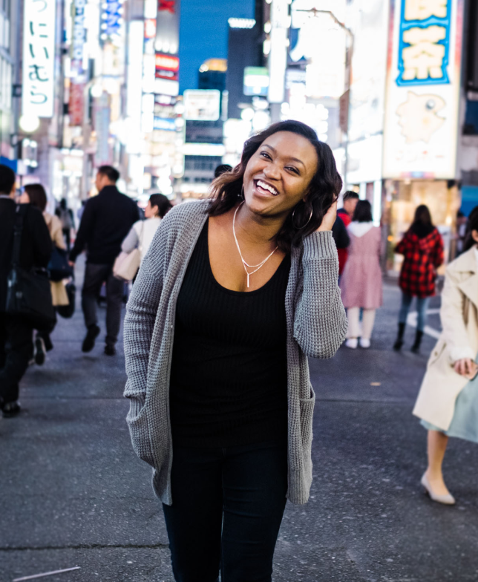
MEET YOUR INSTRUCTOR
Instructor (she/her)
Hi! I’m Chyna. I’m a UX & Product Designer @ Boeing / new part-time freelancer. I love designing digital experiences that are
easy, useful, and valuable.
Master’s Degree in UX Design
Mom of 2 boys (1 yr & 3 yrs old)
Lover of crime & investigation shows

Slide 4
01
ABOUT
What is Ideation?

Slide 5

Ideation is the process of generating a broad set of ideas on a given topic, with no attempt to judge or evaluate them.

Slide 6
Ideation is exploring and identifying potential solutions.
The primary goal of ideation is to spark creativity and innovation.

Slide 7
IDEATION TECHNIQUES
Brainstorming
Bodystorming
Challenging Assumptions
Worst Possible Idea

Slide 8
Problem statement recap:
How might we design a solution for college professors to feel confident teaching a hybrid course in Fall 2021?

Slide 9

02
PROTOTYPING
Recap on Fidelities

Slide 10
Low fidelity (lo-fi) Prototypes:
Lo-fi Prototyping
Prerequisites:
Completed user research (understand user problem, ideated, selected a solution)
Defined requirements (defined scope, user goals, product requirements)
Goals of lo-fi prototyping:
Basic functionality
Information Architecture (IA)
Sizing, spacing, and positioning of product’s elements
Whitespace of UI

Slide 11
Low fidelity (lo-fi) Prototypes:
Lo-fi Prototyping
When to use them?
Mid-meeting or in a workshop
When you’ve got several potential concepts and want to quickly share
During the IA phase where user flows are more important than the specifics
When you want to provoke brutally honest feedback
People feel better about critiquing deliverables that look more like rough workings.

Slide 12
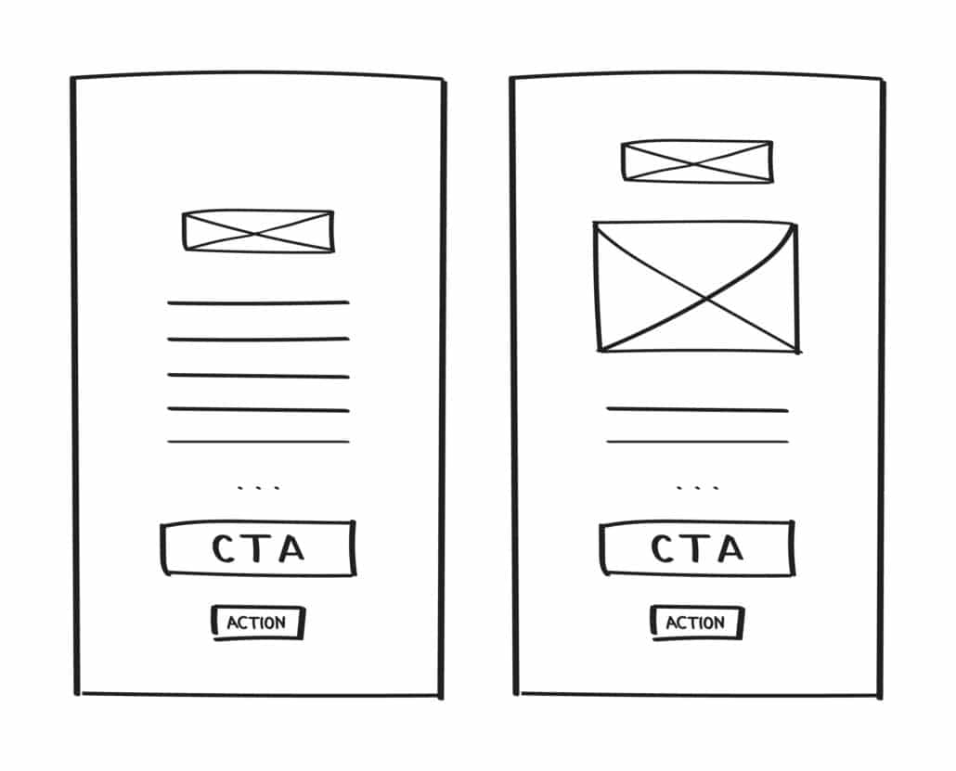
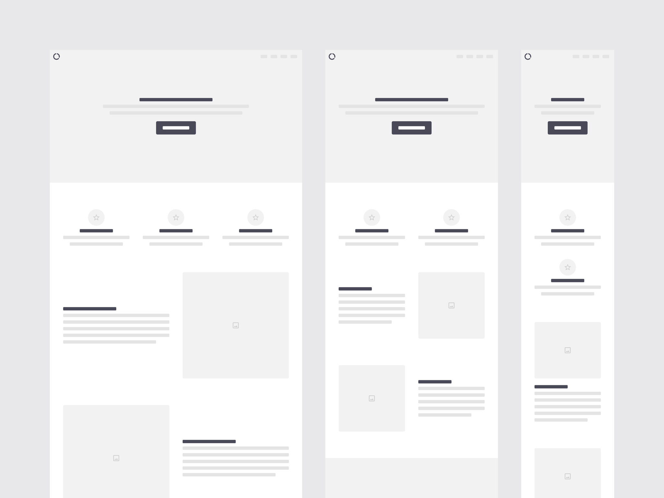
Lo-fi Examples

Slide 13
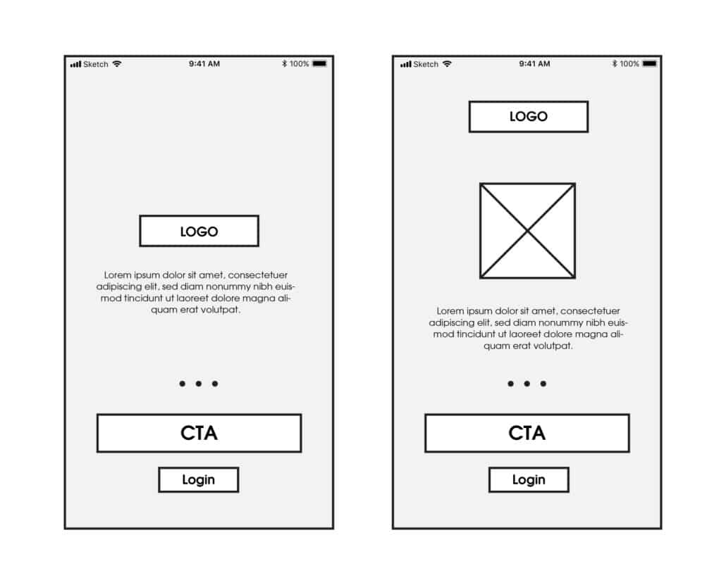
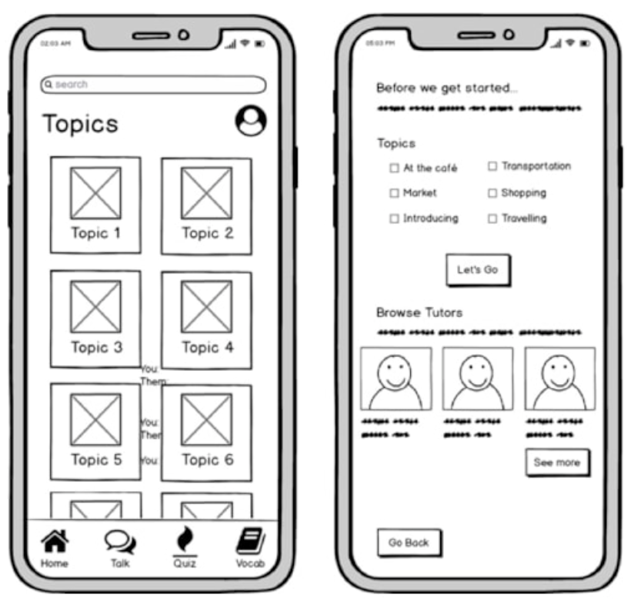
Lo-fi Examples

Slide 14
Medium (Mid) Fidelity Prototypes:
Mid-fi Prototyping
Goals of medium fidelity prototyping:
More accurately define specific elements and visual hierarchy
Varying text weights might be used to separate headings and body content
Detail is given to specific components (ex. buttons vs text-only links)
Specific user flows usually guide screens with basic interactions
(Though still black and white) Use of different shades of grey to communicate visual prominence of certain elements
Avoid final decisions here like color palette, final images, or font styles.

Slide 15
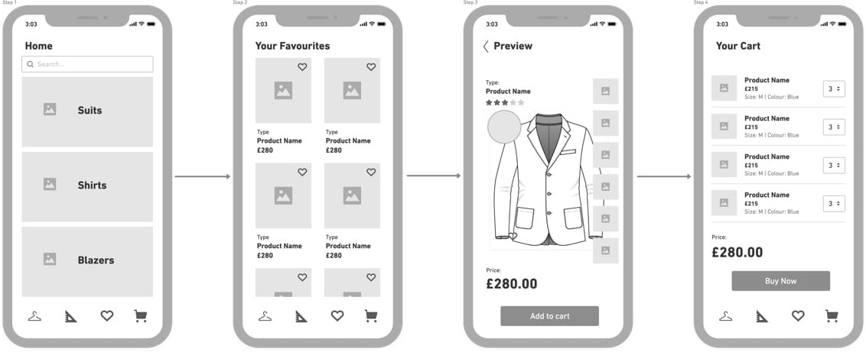
Mid-fi Examples

Slide 16
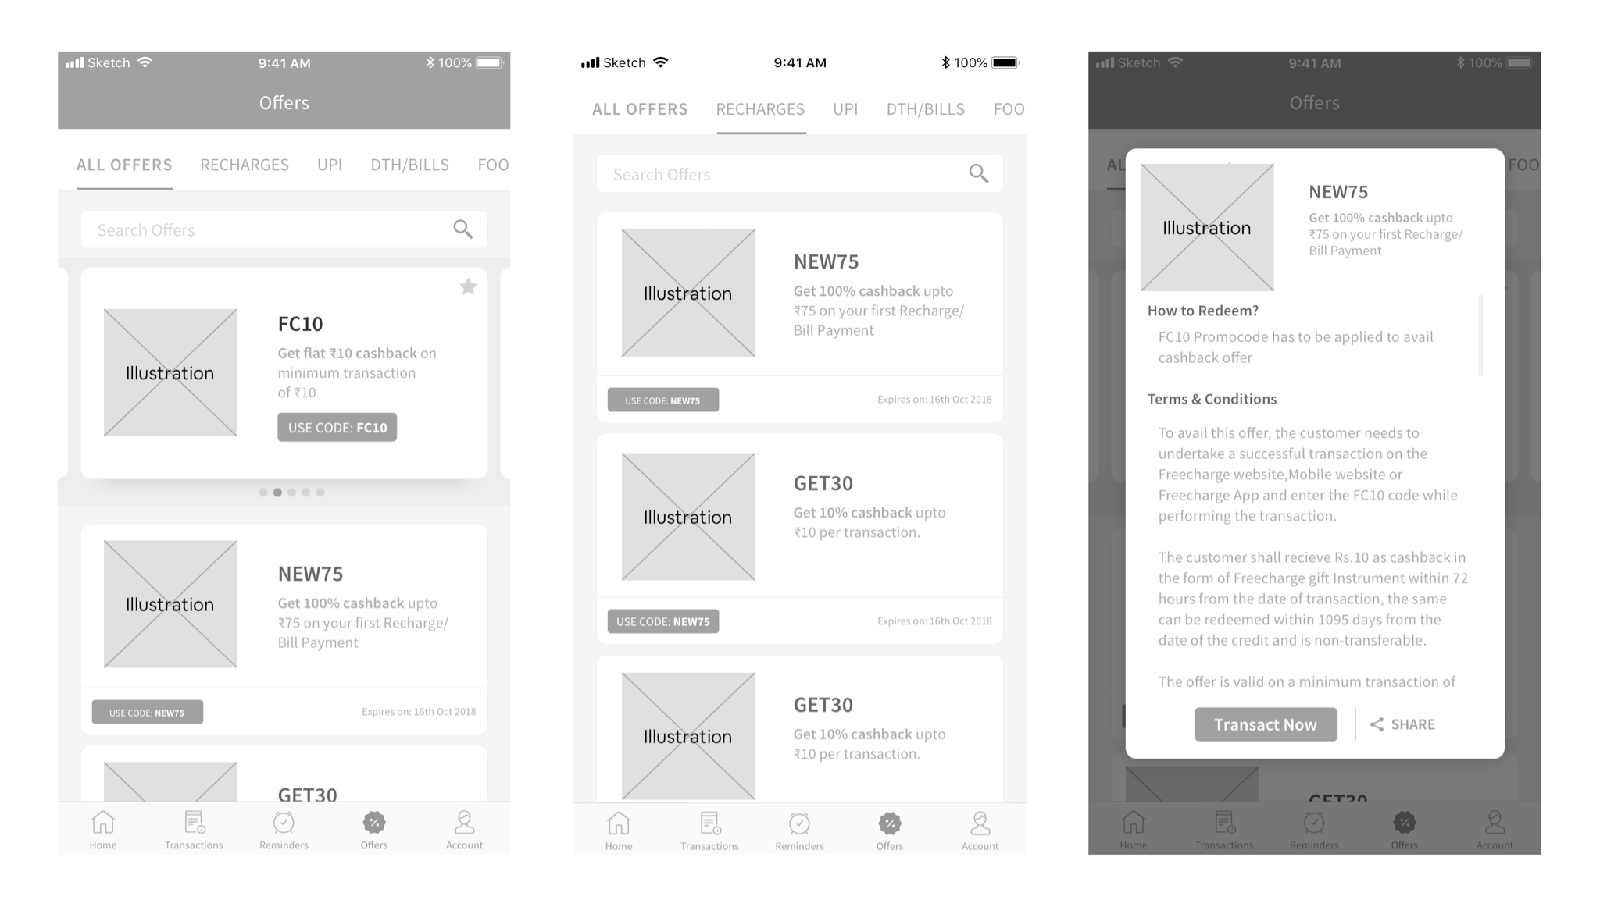
Mid-fi Examples

Slide 17
High fidelity (hi-fi) Prototypes:
Hi-fi Prototyping
Goals
As close to the true graphical representation of the product to allow thorough testing (including UI components, colors, layout, IA, mental load of the screens on users, etc.)
Improve the collaboration with developers to provide a clearer idea on how the application should behave and assist in development time estimates
Can save the company time and money by building a ‘free’ product and testing vs launching the real product

Slide 18
High fidelity (hi-fi) Prototypes:
Hi-fi Prototyping
When to use them?
When you have visual designs of your product
When you want to test the details of your products in terms of UI elements, color schemes or copy
When you want to test interactive elements like transitions, animations, micro-interactions
When you want to know how your target users feel about your product and to capture the most authentic user feedback
Hi-fi prototypes are made as close to the true graphical representation of the product.

Slide 19
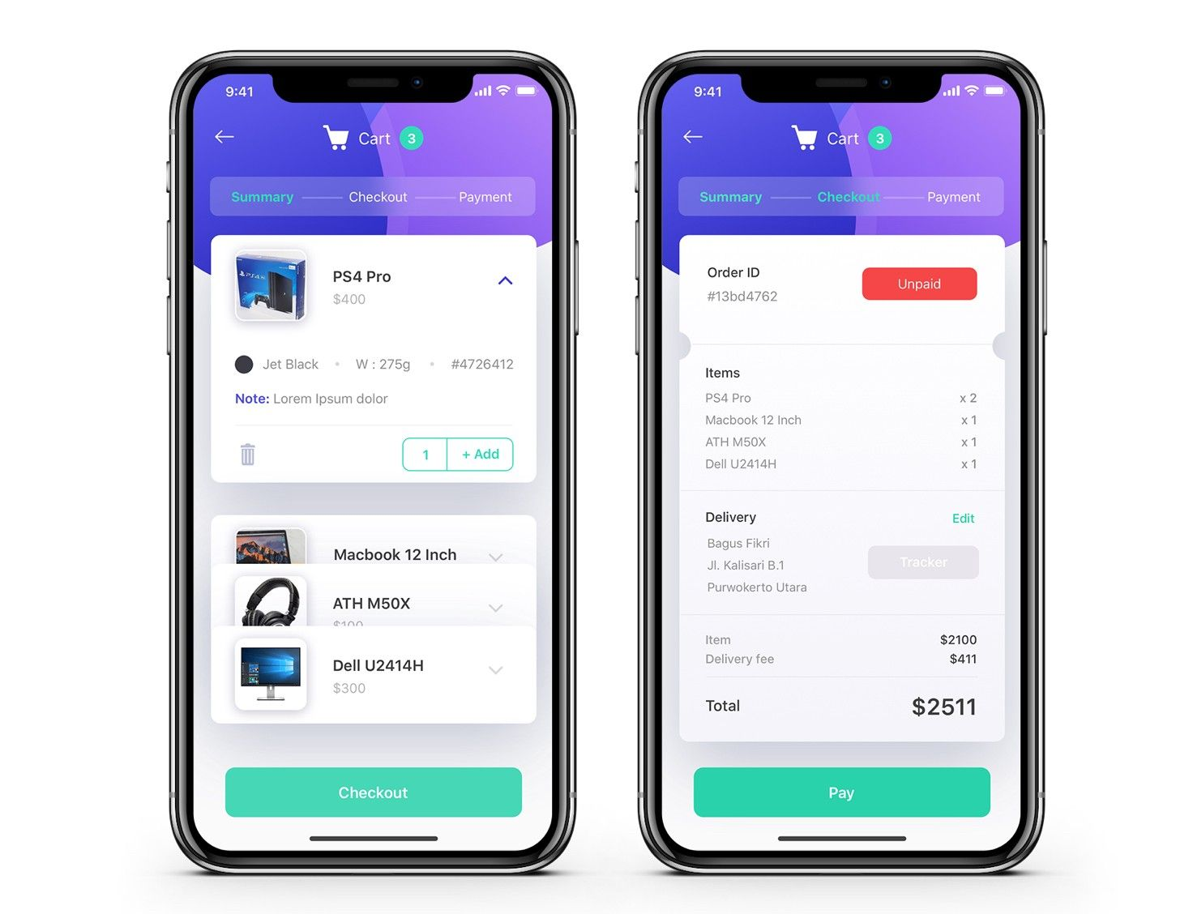
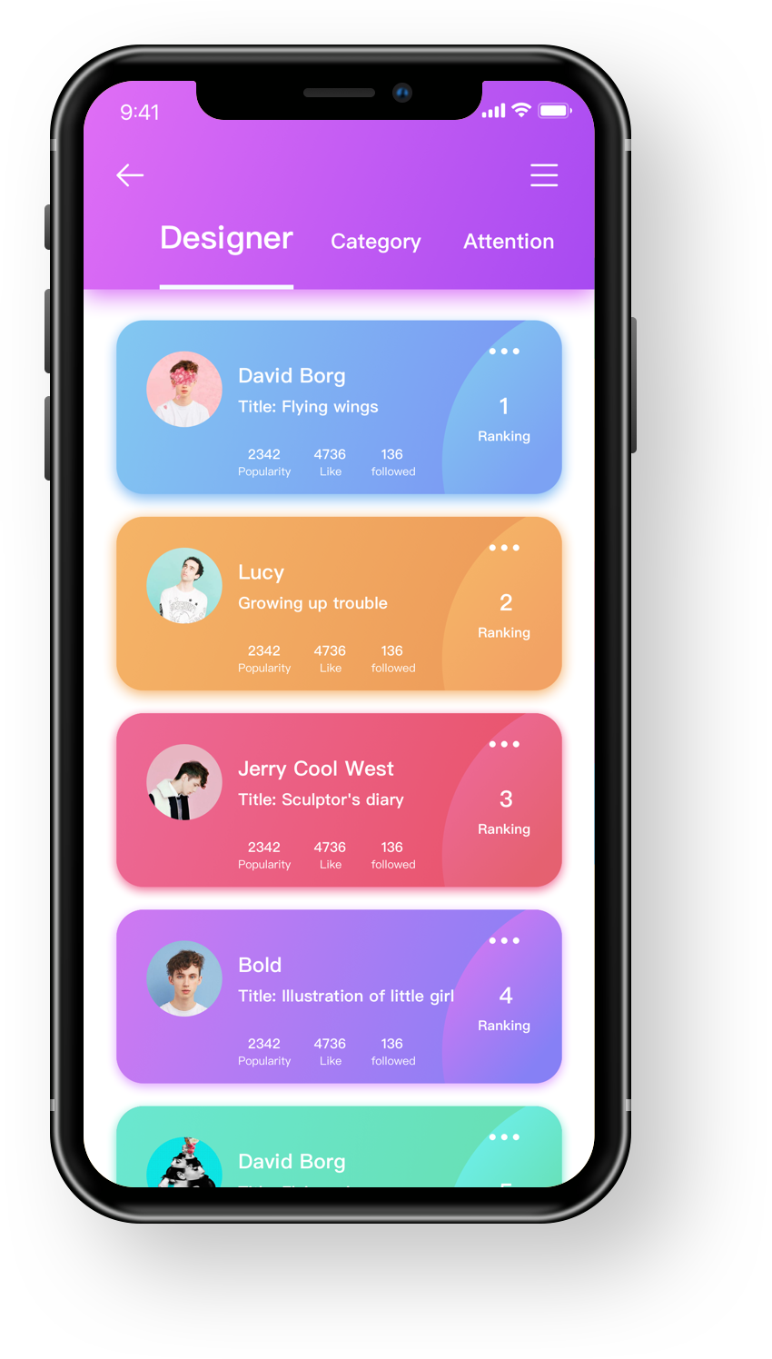
Hi-fi Examples

Slide 20
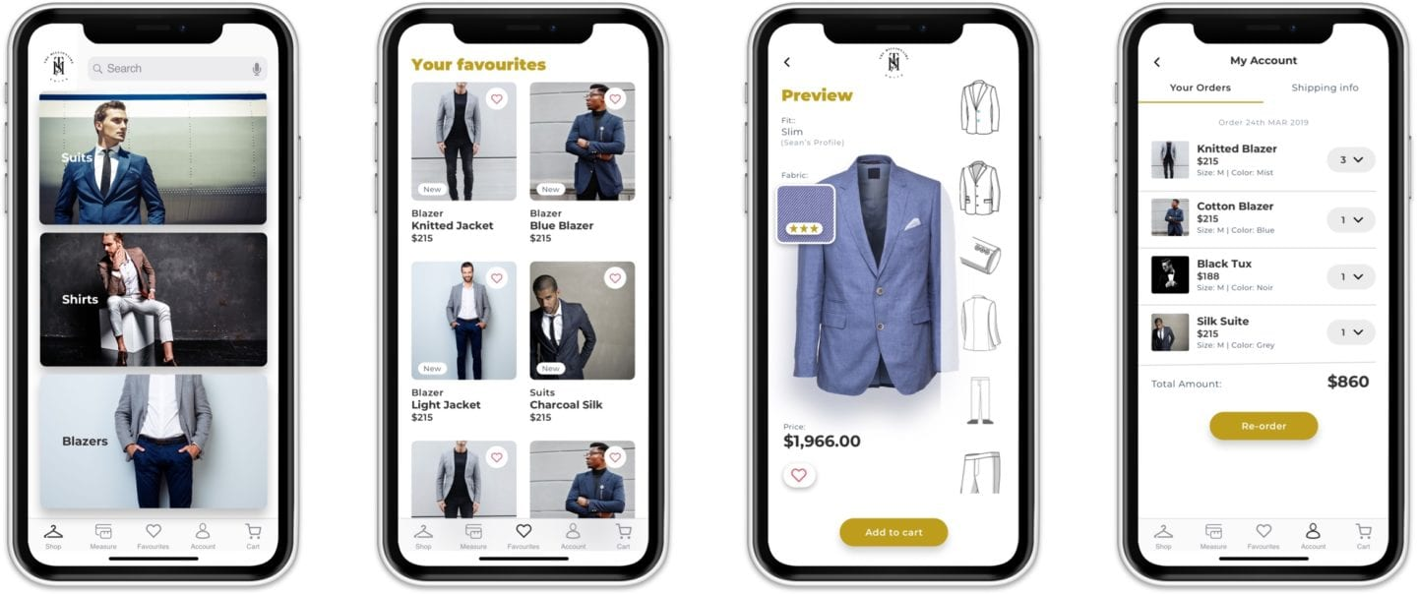
Hi-fi Examples

Slide 21
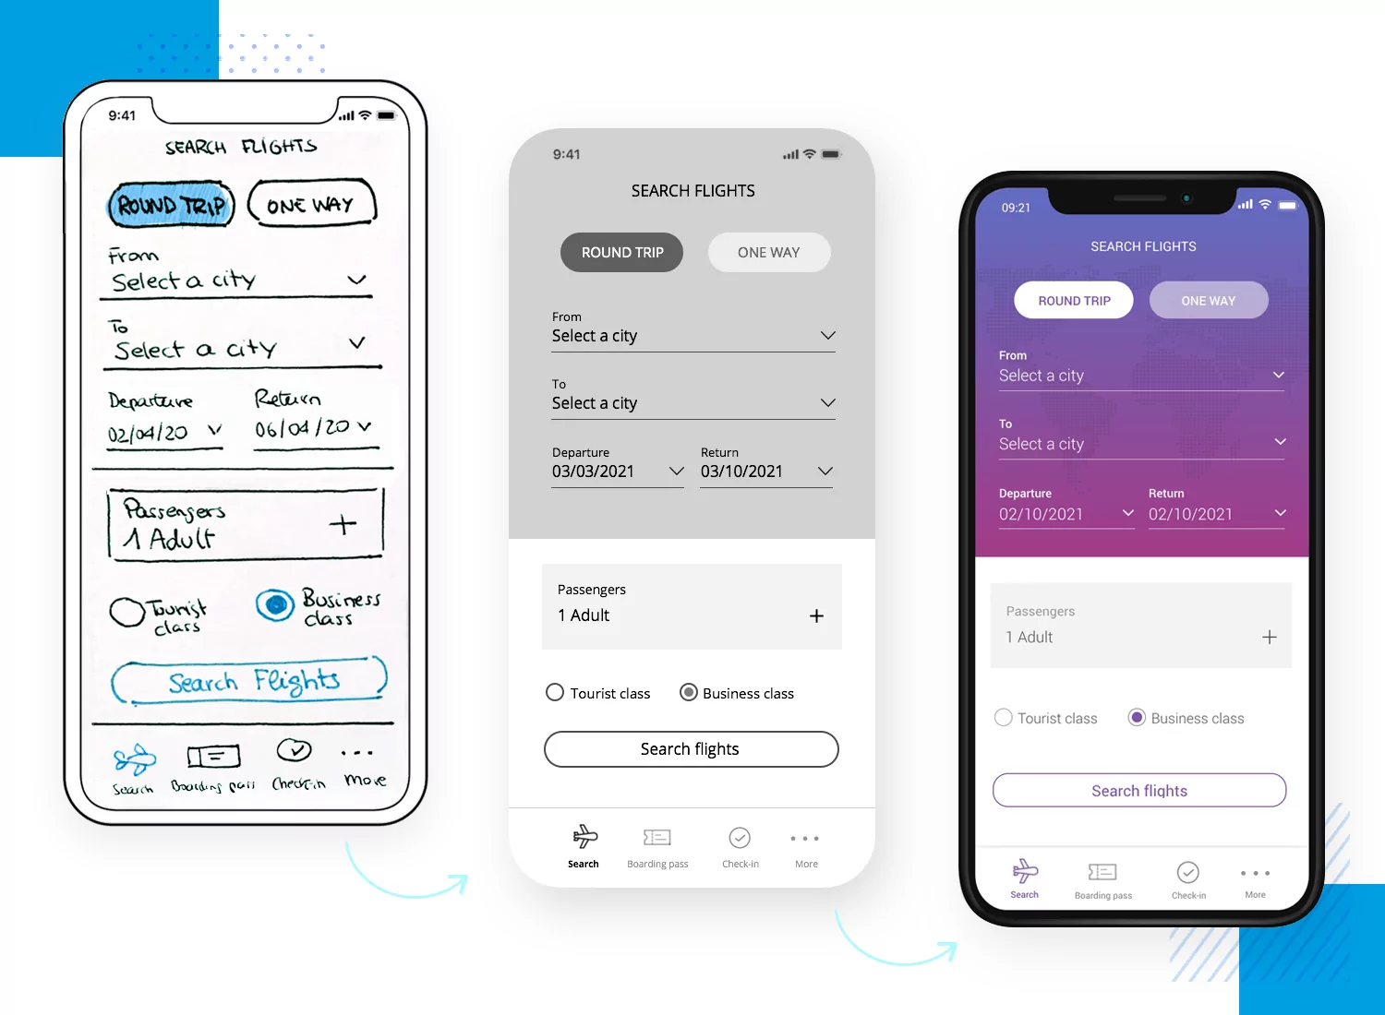
Our Class Goal

Slide 22
Example Hi-fi Prototype:
Food Truck App
(Single User Flow)

Slide 23
03
ABOUT
Style Guides

Slide 24
A style guide is a reference tool or set of standards that helps maintain consistency in a product’s overall look and feel.
It serves as the single source of truth for user interface design which creates cohesive UX.

Slide 25
Key Components of a Style Guide:
Key Components
This resource is created in partnership with a visual designer (or similar).
Logo & Brand Guidelines
Typography
Color Pallette
Iconography
Imagery
UI Elements

Slide 26
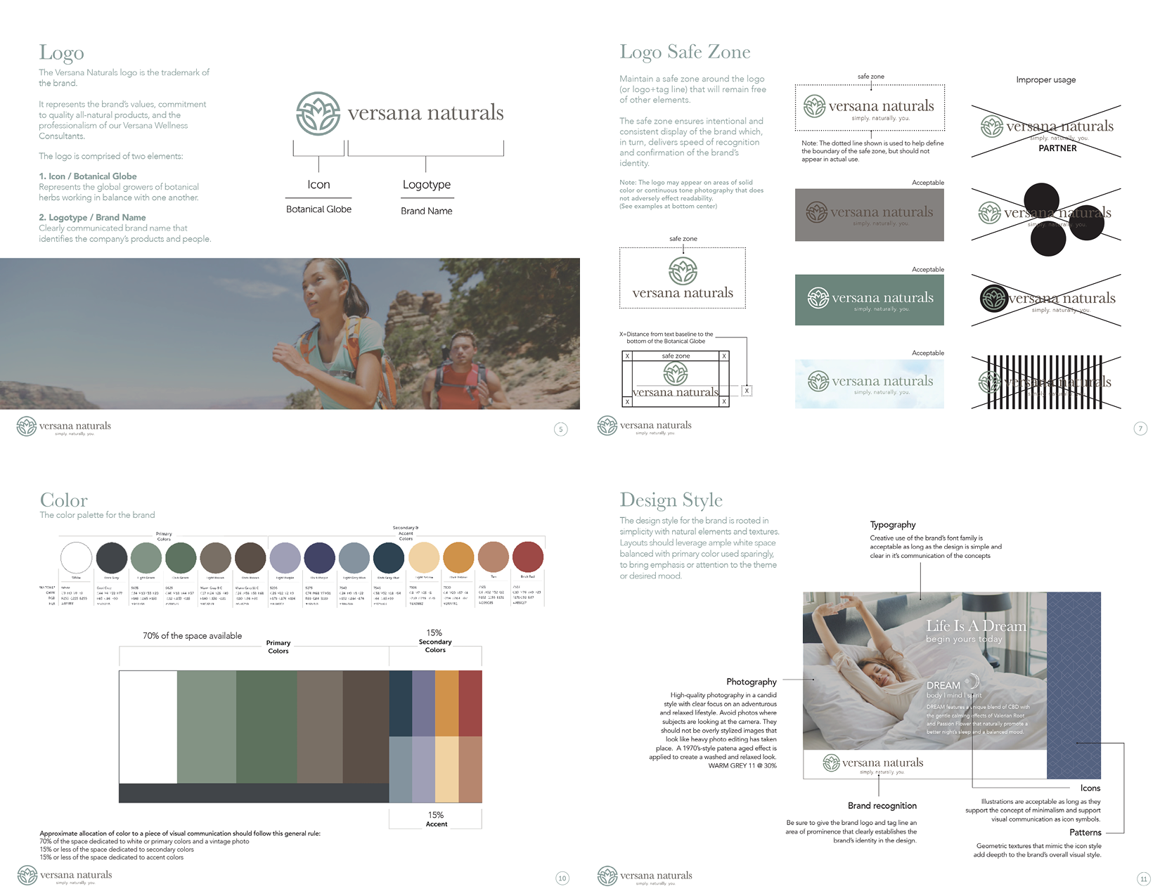
Style Guide Example

Slide 27
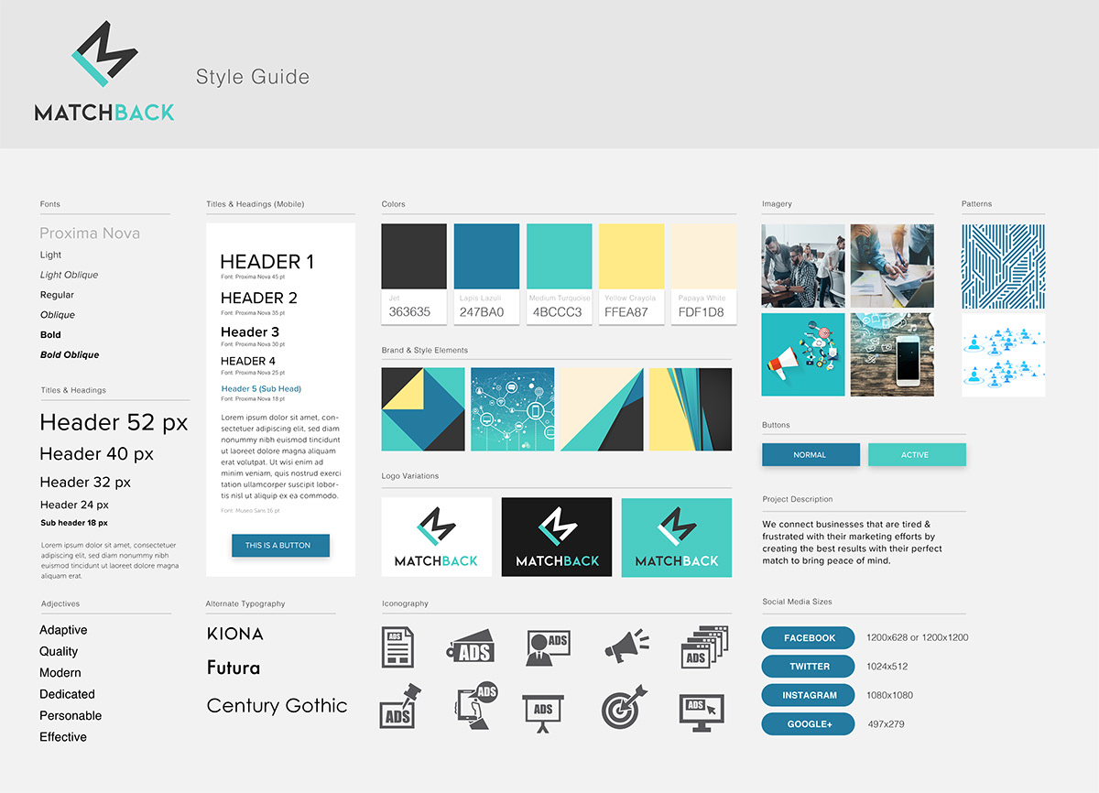
Style Guide Example

Slide 28
First Things First
Buttons & Menus
Time-Saving Resources
Icons & Images
Figma Topics
Typography
Interactions & Prototyping
Columns and Grid Layouts, Page Constraints, Organization
Auto layout*, Components, Color Picker, Shadowing
Google, Plug-ins, Fill vs Stretch,
Color Editing, Masks, Layers
Components, Plug-ins, Keyboard Shortcuts, Style Guides, Resource Libraries
Weights, Visual hierarchy,
My go-to fonts
Standard settings, Smart animate, Prototype view settings, Viewing/Exporting

Slide 29
Questions?

Slide 30
Homework:
Continue iterating on your current prototype to get it as close as possible to a hi-fi prototype.

Slide 31
Watch + Read Resources:
Figma Keyboard Shortcut Cheat Sheet
Auto Layout Crash Course (10 min vid)
Comprehensive Figma Tips & Tricks (25 min vid)
Designing Microinteractions
How to Simplify Your Designs
Hire Black Female Creatives

Slide 32
Websites:
Clutch.co - Thousands of sites. Inspo everywhere
Awwwards - Cool site for voting & inspo
Unsplash - Free, ready to use pictures (no royalties)
Coolors - Color palette generator
Contract Accessibility Checker - Make sure your designs are created for EVERYONE :)

Slide 33
Office Hours:
Thursday, July 8
5:00 - 6:00pm EST
For questions + convo

Slide 34
Thank You!
chyna.msmith@gmail.com
www.linkedin.com/in/chynasmith
chynamsmith.com

